Slide 1


Presentation on
“Advanced Phishing Detection Using Hybrid A.I. Models”
Submitted To: Submitted by:
Ms. Nidhi Bhatla Suhail Kataria(2417163), Arpita Choudhary(2320457),
Rimjhim Sharma(2320487).
College Of Engineering
1
Notes:
1

Slide 2


Abstract
Phishing attacks are a major cybersecurity threat that exploit both email content and malicious URLs. Traditional detection methods often fail in real-world scenarios due to their reliance on a single type of analysis.
This project proposes a hybrid phishing detection system that combines machine learning with rule-based intelligence to improve detection accuracy and robustness.
System Approach
Transformer-based email analysis (DistilBERT)
URL structure and pattern analysis
Joint decision using combined signals
Key Features
Multi-mode detection:
SOC (high recall)
Balanced
High-confidence
Explainable results for each prediction
Batch analysis support
Outcome
Improved cross-domain detection
Reduced false positives and false negatives
Achieved ~90%+ accuracy on evaluation dataset
College Of Engineering
2

Slide 3

Introduction
Phishing is one of the most common cyber attacks used to steal sensitive information through fake emails and malicious links.
Traditional detection systems:
rely on either email or URL analysis
fail in cross-domain scenarios
Problem:
Attackers combine multiple techniques
Single-model detection is not reliable
High false positives and false negatives
Solution
Combine email + URL analysis
Use hybrid detection approach
Apply rule-assisted decision logic
Motivation
Increase detection accuracy
Improve real-world applicability
Provide explainable results for users
College Of Engineering
3

Slide 4
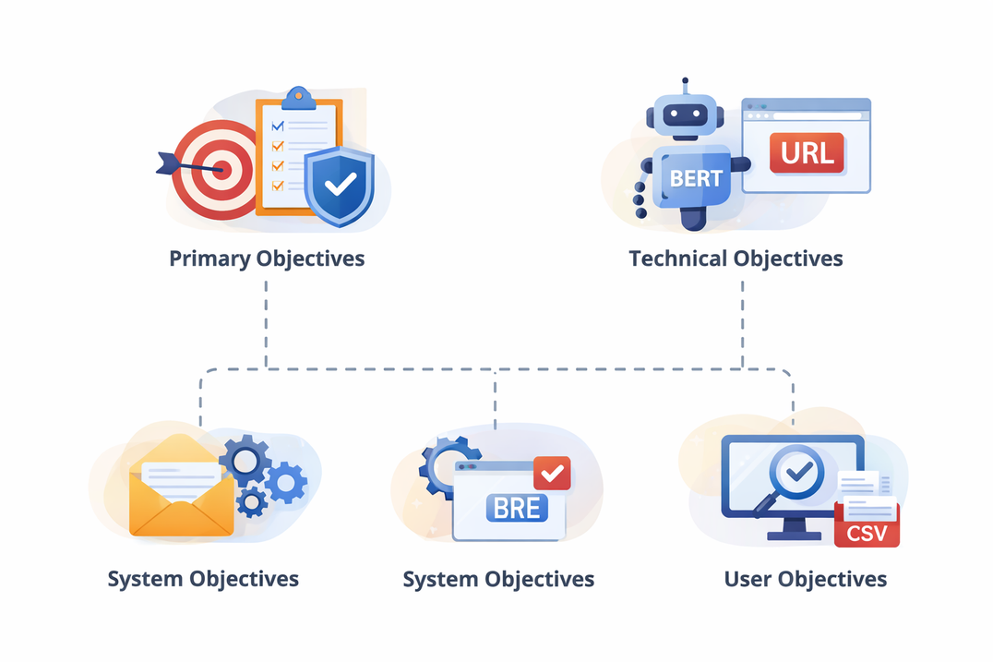
Objectives of Project
Primary Objective:
Develop a robust phishing detection system
Improve detection accuracy in real-world scenarios
Technical Objectives:
Use transformer-based model for email analysis
Analyze URL structure and patterns
System Objectives:
Combine email and URL signals
Implement rule-assisted decision logic
User Objectives:
Provide clear and explainable results
Support batch analysis for multiple inputs
College Of Engineering
4

Slide 5
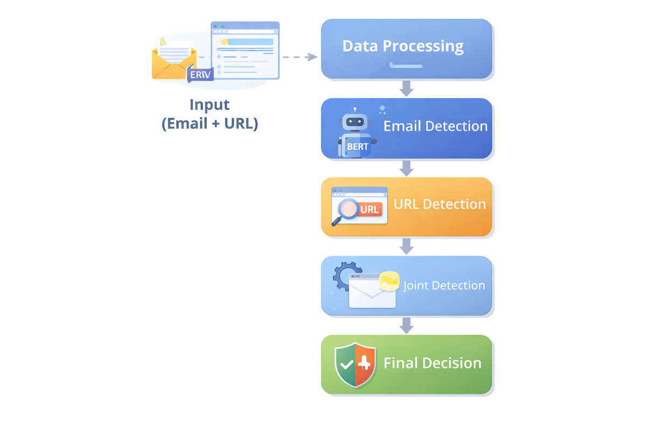
Methodology
Step 1 — Data Processing
Extract email content (subject + body)
Extract URLs from input
Clean and prepare data
Step 2 — Email Detection
Use DistilBERT transformer model
Capture contextual phishing patterns
Generate email risk score
Step 3 — URL Detection
Analyze domain structure
Detect suspicious keywords & patterns
Generate URL risk score
Step 4 — Joint Detection
Combine email + URL scores
Apply rule-based logic:
trusted domain validation
brand mismatch detection
suspicious signal escalation
Step 5 — Final Decision:
Apply threshold-based classification
Output:
Safe / Suspicious / Phishing
Explanation + confidence score
College Of Engineering
5

Slide 6
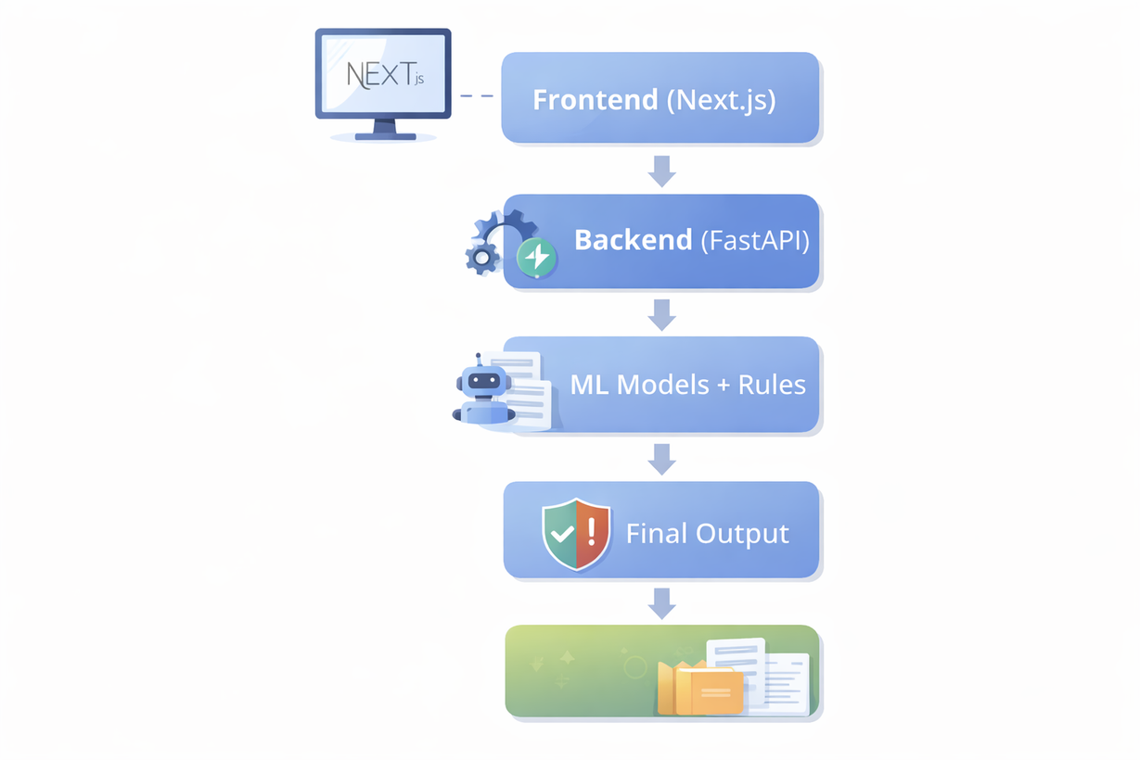
Implementation
Tech Stack:
Frontend: Next.js + Tailwind CSS
Backend: FastAPI
ML Model: DistilBERT (Email Detection)
Core Modules:
Email Detection Module
URL Analysis Engine
Joint Detection System
Key Features Implemented:
Transformer-based email classification
URL structure & pattern analysis
Rule-assisted joint scoring
Advanced Features:
Threshold-based detection modes
Batch CSV analysis
Explainable output (reason-based results)
College Of Engineering
6

Slide 7
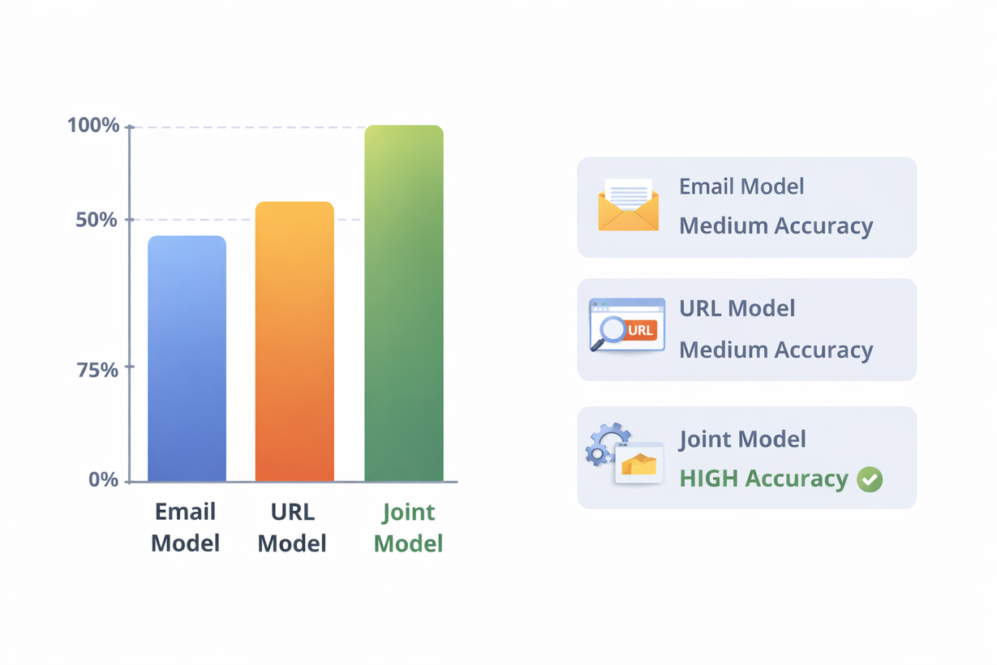
Results & Discussion
Model Performance
Email model → high recall
URL model → high precision
Final Joint Model
Accuracy: ~90–94%
F1 Score: ~0.94–0.95
Key Improvements
Better cross-domain detection
Reduced false positives
Reduced false negatives
Key Observations
Hybrid approach outperforms single models
Threshold tuning improves performance
Rule-based logic enhances reliability
College Of Engineering
7

Slide 8

Future Scope
Model Improvements
Use larger real-world datasets
Improve zero-day phishing detection
System Enhancements
Real-time detection system
Integration with threat intelligence
Deployment
Browser extension
Email client integration
UI & User Experience
Advanced dashboard for analysts
Improved visualization and reporting
College Of Engineering
8

Slide 9
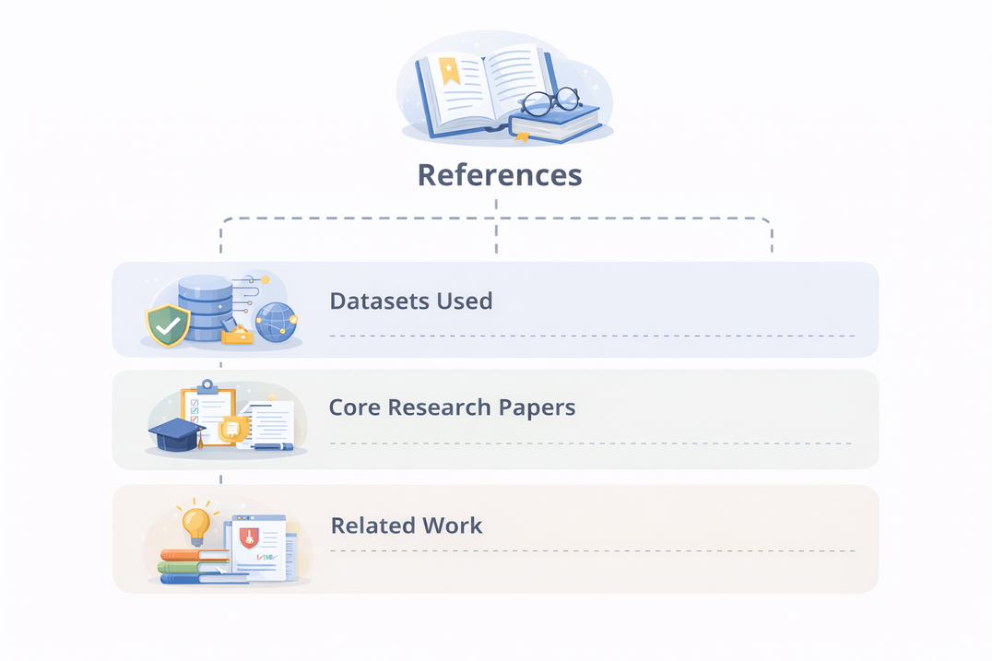
References
Datasets Used:
Enron Email Dataset (Klimt & Yang, 2004)
SpamAssassin Public Corpus
Nazario Phishing Corpus
Benign URLs: Top-1M Dataset
Phishing URLs: PhishTank Dataset
Core Research Papers:
Devlin et al., BERT: Language Understanding, 2019
Sanh et al., DistilBERT Model, 2019
Metsis et al., Naive Bayes Spam Filtering, 2006
Fawcett, ROC Analysis, 2006
Pedregosa et al., Scikit-learn, JMLR
Related Work:
AI-Based Phishing Detection Techniques (ResearchGate)
Role of AI in Phishing Detection (Zenodo)
Hybrid ML Model for Phishing Detection (IEEE)
Phishing Detection using URL Analysis (IEEE Access)
Review of AI-Based Phishing Models (IEEE OJ-COMS)
College Of Engineering
9

Slide 10
Thank You
Queries?
College Of Engineering
10

